Slide 1
Final Goal Calibration
Team SegFault
Byungju, Manoj, Mateusz

Slide 2

Initial Objective
We set out to implement the methodology described in the work Generative and Discriminative Voxel Modeling with Convolutional Neural Networks.
A dataloader system was needed in order to convert the database’s .off files into workable voxel objects.
This would consist of the design of a machine learning model (a variational autoencoder) to train on the Princeton ModelNet database.
The model would then be able to generate voxel objects given a random seed. We would use voxel-based convnets for object classification.
A GUI would be developed that displays generated objects as well as providing a user interface to dynamically interpolate between models.

Slide 3
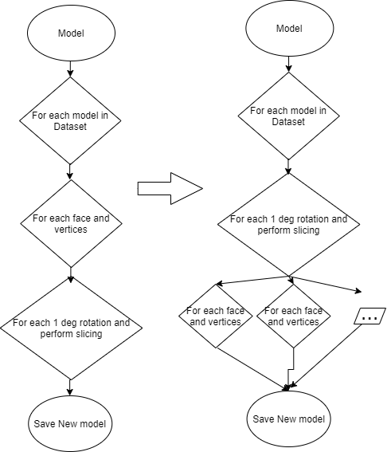
Dataloader (Feed Preprocessing)
Code conversion improved performance in space complexity from ~10GB RAM occupancy as mentioned in the matlab code to ~2GB RAM
Using OpenMP to Muti-thread the matrix rotation and slicing.
Now we could do it online in training and testing.
(Can be used for Real-time)

Slide 4
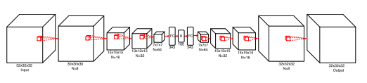
Variational Autoencoder Architecture

Slide 5
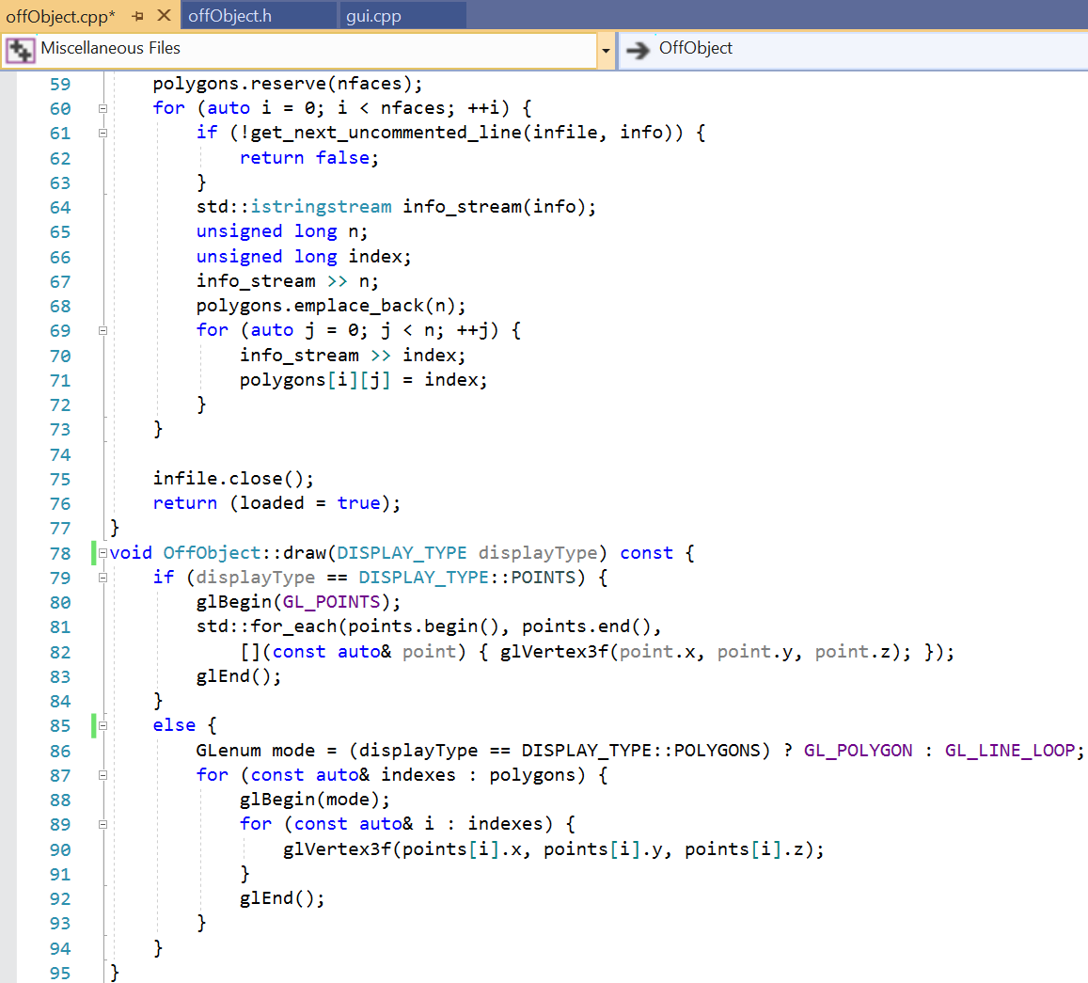
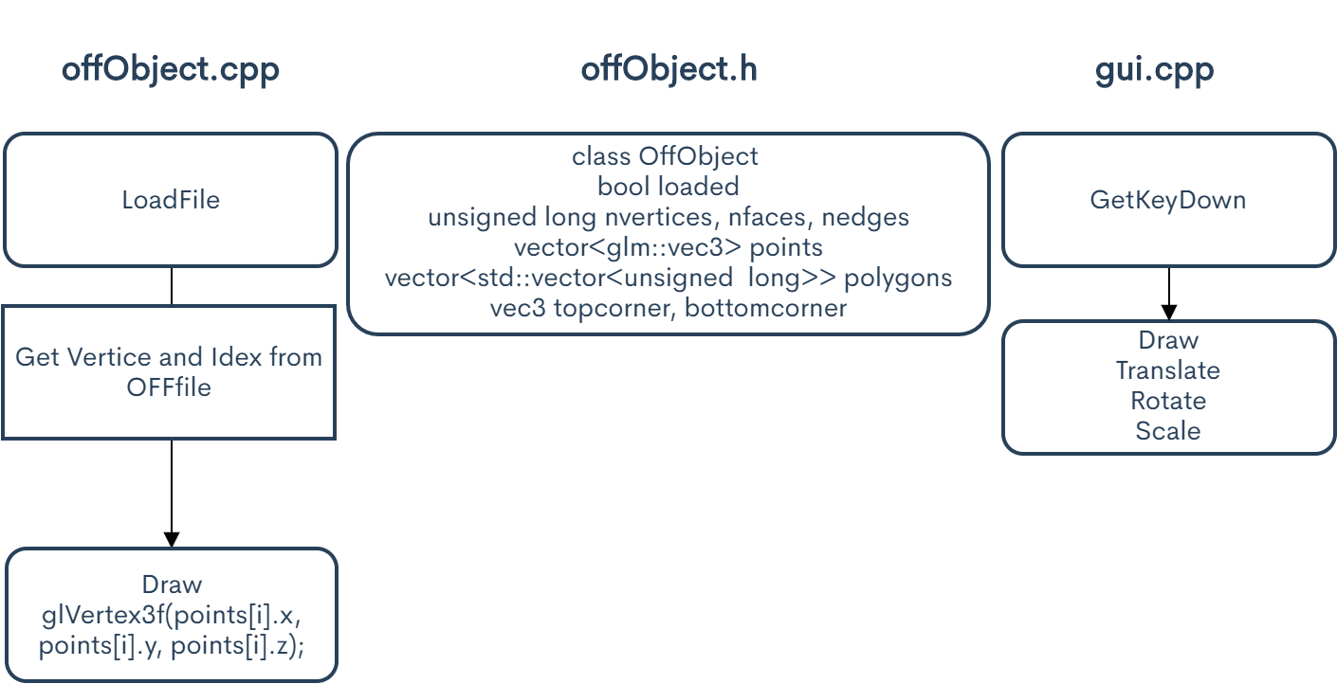
GUI code

Slide 6
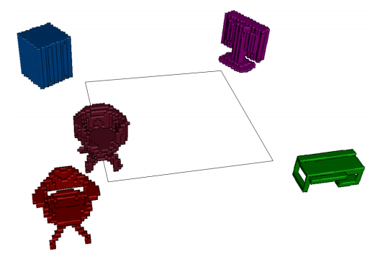
GUI Display

Slide 7
Concerns to Address
C++ Tensorflow API does not natively possess certain functionalities (such as 3D batch normalization), thus requiring some workarounds.
Processing the database proved to be more involved than initially thought.
Data loading in C++ requires O( n^2 + k ) (n>k) based on batchsize. Reduction in time complexity with rotating first and voxelizing to O( k^2 + n ).
Advanced features of GUI, such as interpolation between objects, as well as voxception based classifiers, have proven to be rather complex and time-consuming to implement.

Slide 8
Project Adjustment and Final Deliverables
We will have a functioning dataloader and VAE model, capable both of training on and generating these voxel objects.
We intend to table the implementation of Voxception classifiers, though we may given time availability. (According to time available)
Our GUI will display models of the training set and generated objects, as well as the progress of the VAE, but we do not intend to featured

Slide 9
Any Questions?

